Slide 1
Dash Plotly
Module 02
Data Science Developer

Slide 2
Plotly
Plotly is a library that allows you to create interactive plots that you can use in dashboards or websites (you can save them as html files or static images).

Slide 3
Dash
Dash is a productive Python framework for building web applications.
Written on top of Flask, Plotly.js, and React.js, Dash is ideal for building data visualization apps with highly custom user interfaces in pure Python. It's particularly suited for anyone who works with data in Python.

Slide 4
Installation
pip install dash==0.26.5 # The core dash backend
pip install dash-html-components==0.12.0 # HTML components
pip install dash-core-components==0.26.0 # Supercharged components

Slide 5
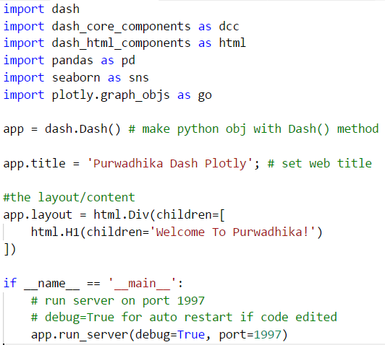
Imports and Setup (First Code)

Slide 6
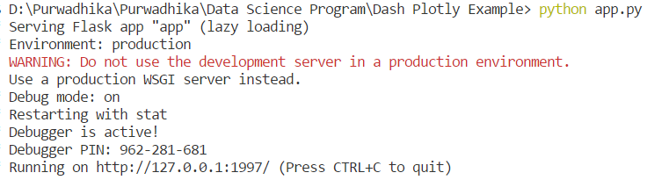
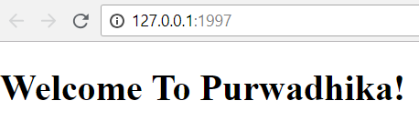
Run The Program

Slide 7
Dash HTML Components
Dash is a web application framework that provides pure Python abstraction around HTML, CSS, and JavaScript.
Instead of writing HTML or using an HTML templating engine, you compose your layout using Python structures with the dash-html-components library.
Open this link for details :
https://dash.plot.ly/dash-html-components

Slide 8
Dash Core Components
Dash ships with supercharged components for interactive user interfaces. A core set of components, written and maintained by the Dash team, is available in the dash-core-components library.
Open this link for details :
https://dash.plot.ly/dash-core-components

Slide 9
Load Dataset

Slide 10
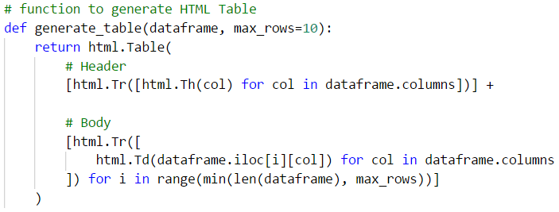
Create Function generate_table

Slide 11
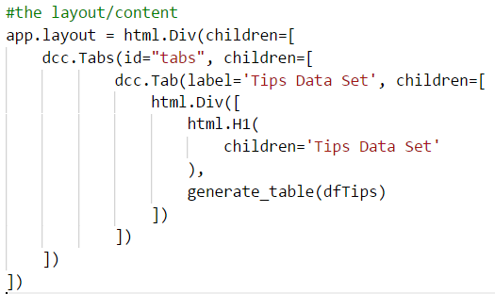
Change The Layout

Slide 12
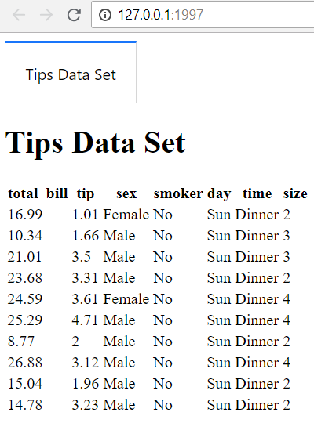

Slide 13
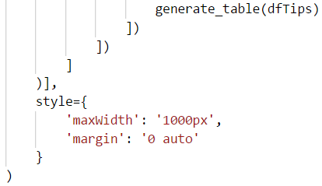
Give Style(CSS) to Parent Div
Now the Div will be on the center of the screen because of the margin : 0 auto, and the Div max width will be = 1000px.

Slide 14
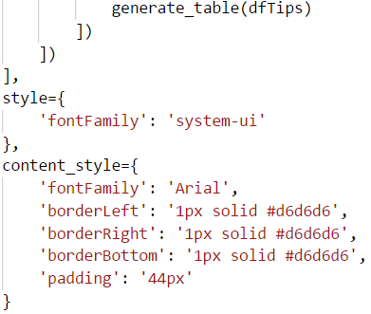
Give Style(CSS) to dcc.Tabs
Now the tabs fontFamily = system-ui
and the content of dcc.Tabs will have a border on all sides except the top, and the fontFamily changed to Arial

Slide 15
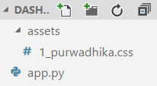
Adding & Using CSS Files
Create css file 1_purwadhika.css inside new assets folder
The CSS files on the assets folder will automatically imported and used by the app.py because of Dash
Dash will include the files in alphanumerical order by filename. So, we recommend prefixing your filenames with numbers if you need to ensure their order (e.g. 10_typography.css, 20_header.css)

Slide 16
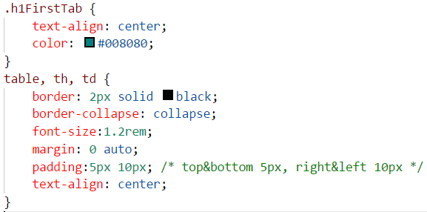
1_purwadhika.css

Slide 17
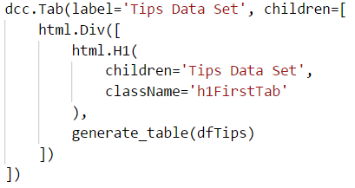
App.py
Give className property to H1 Element inside first Tab, and the value = ‘h1FirstTab’

Slide 18
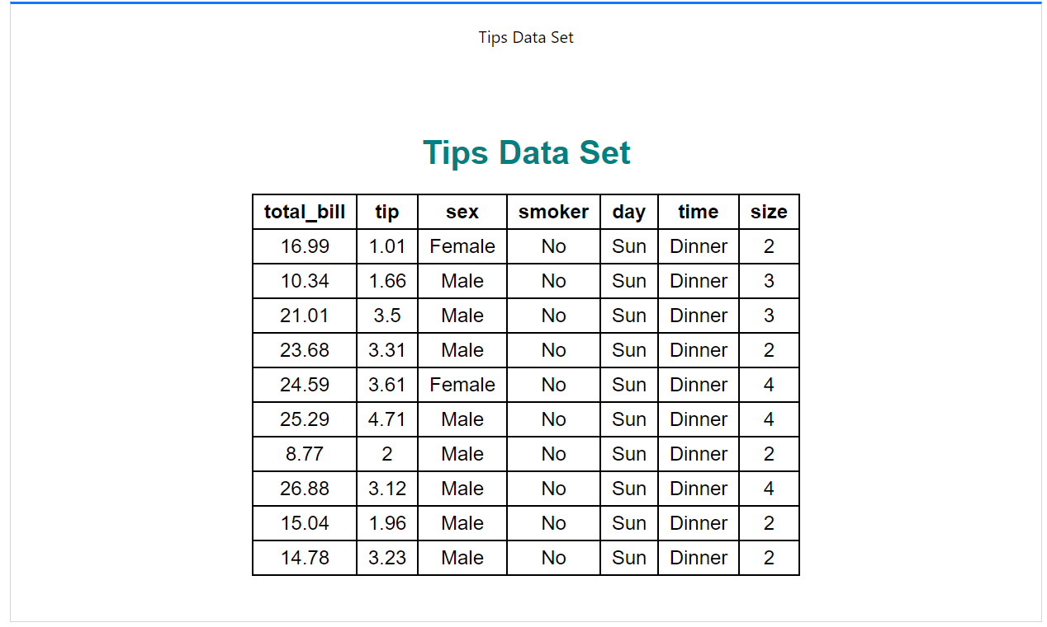

Slide 19
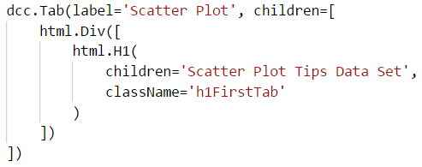
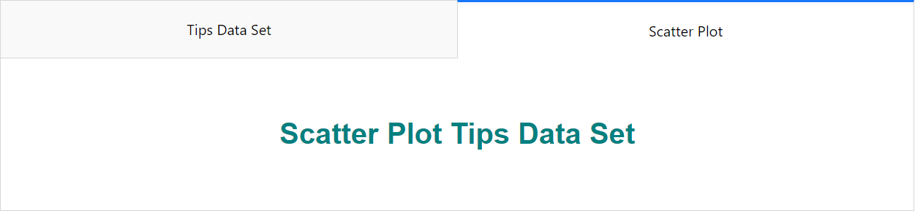
Add New Tab

Slide 20

Add Python List color_set

Slide 21
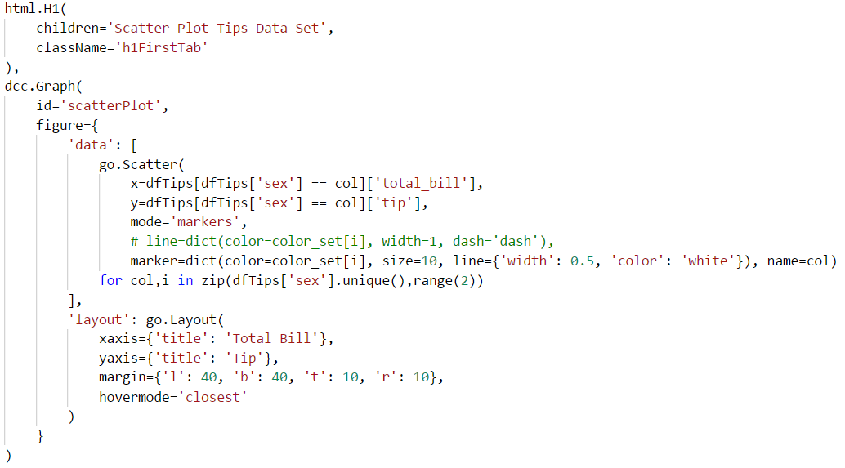
Add dcc.Graph below H1 Tab 2

Slide 22
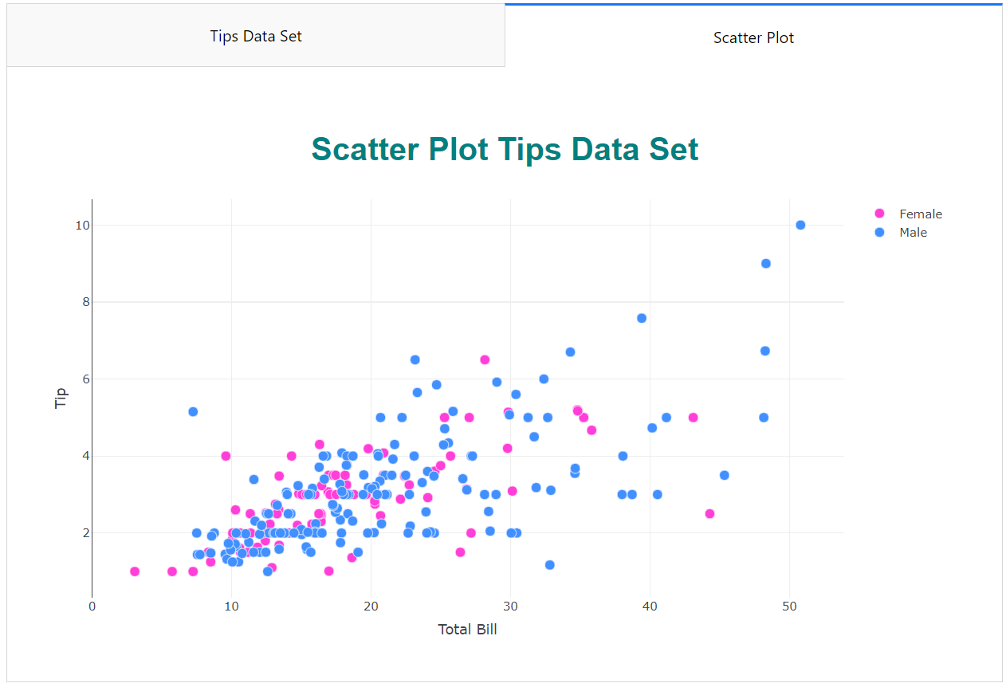

Slide 23
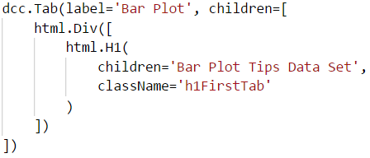
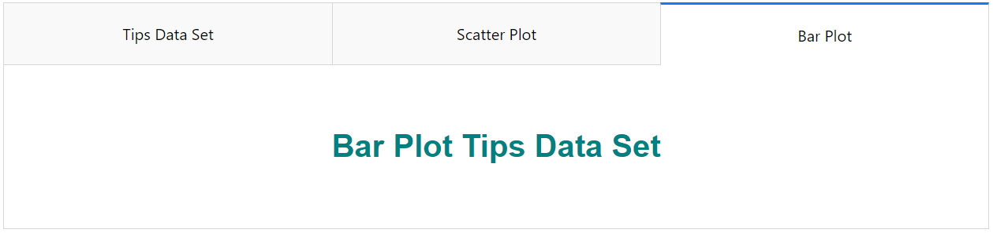
Add New Tab

Slide 24
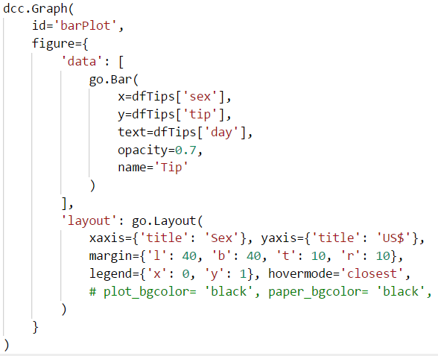
Add dcc.Graph below H1 Tab 3

Slide 25
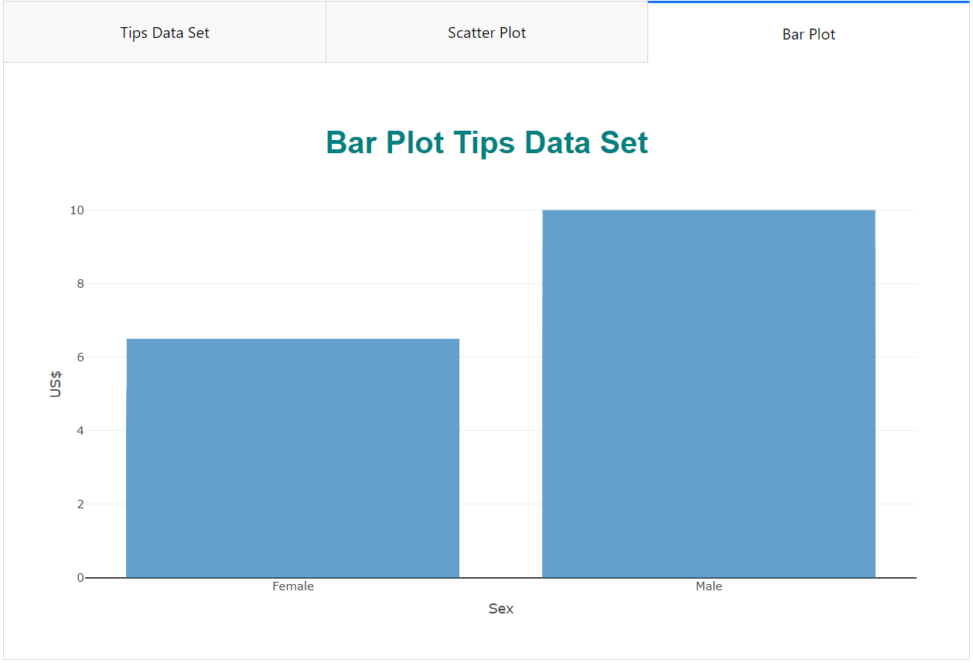

Slide 26
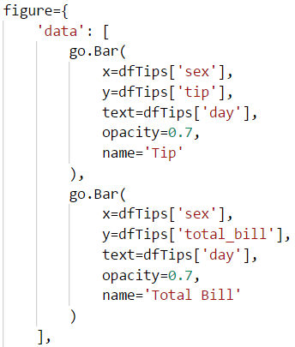
Add more go.Bar to figure data List

Slide 27
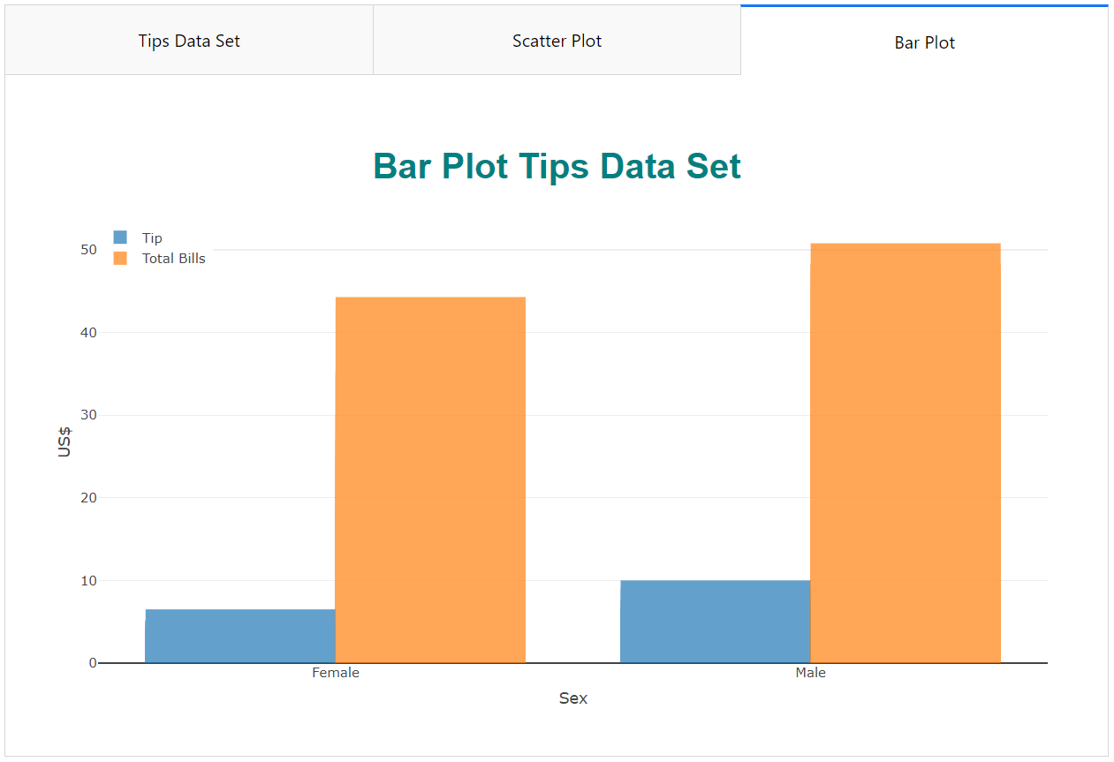

Slide 28
Basic Dash Callbacks
Basic Dash Callbacks make your Dash apps interactive.
Lets get started!
For more details : https://dash.plot.ly/getting-started-part-2

Slide 29
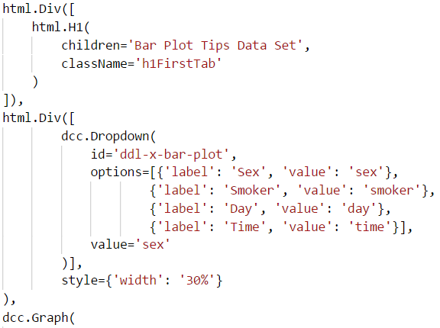

Add Dropdown below H1 Tab 3

Slide 30
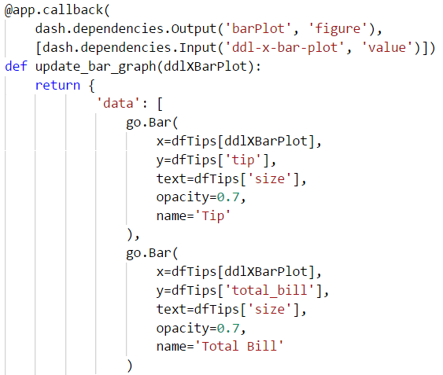
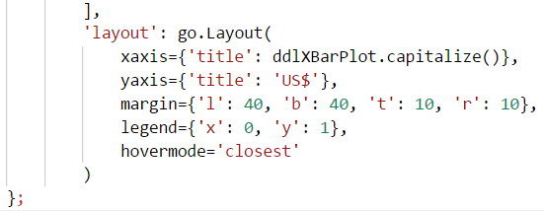
Add @app.callback and new function
Put it after app.layout. ddlXBarPlot parameter will be filled with ddl-x-bar-plot value, and the value that returned by the update_bar_graph function will fill the figure property of the barPlot

Slide 31
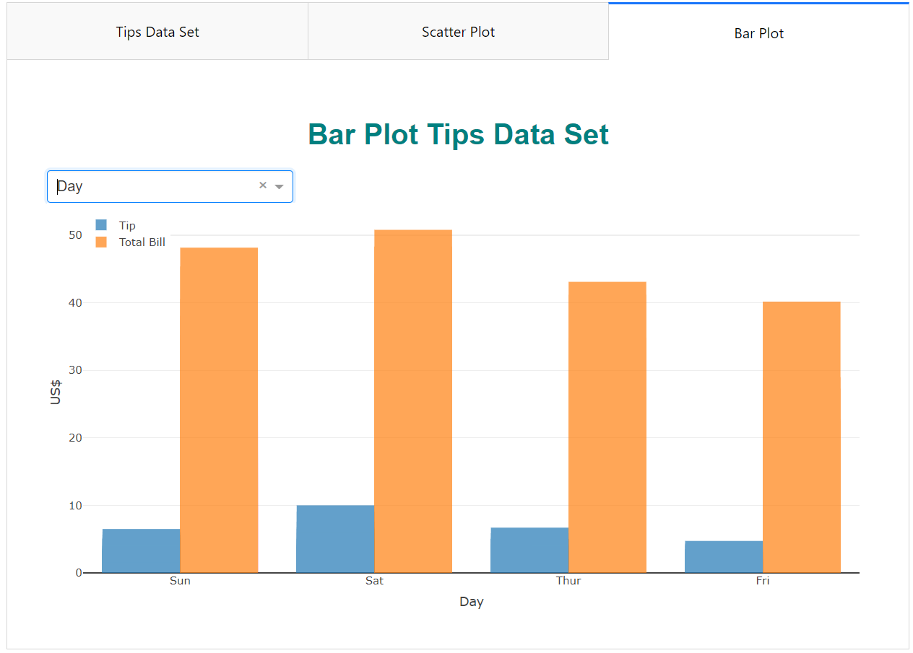

Slide 32
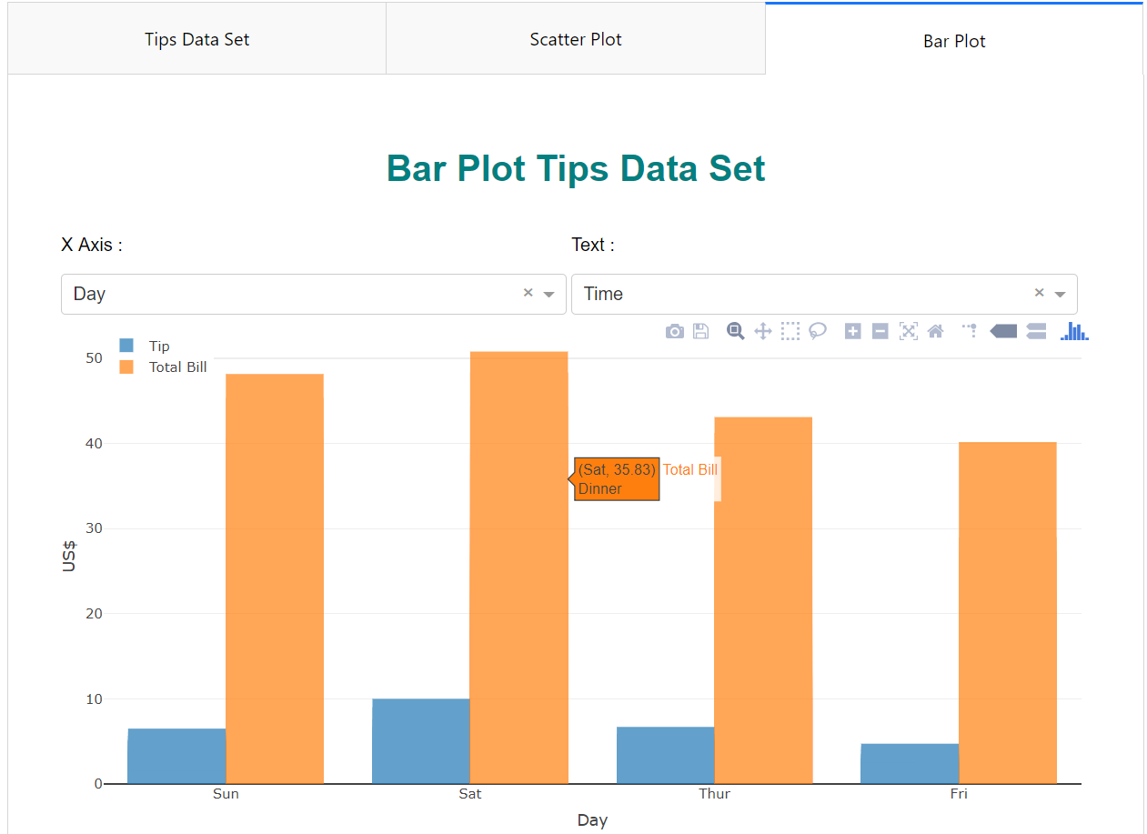
Multi Input Callback
Challenge! make it like this!

Slide 33
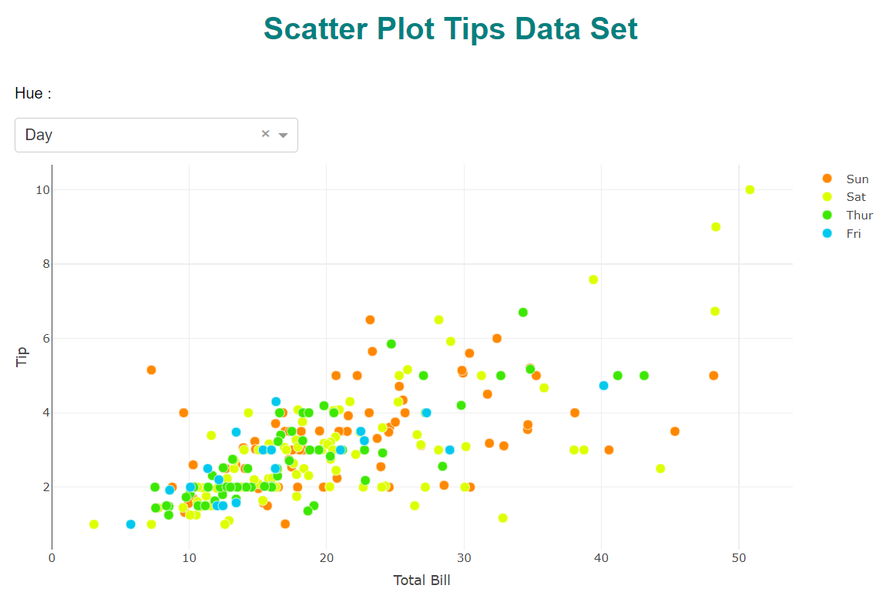
Multi Output Callback
Challenge! make it like this!

